Slide 1
CometApp
Group – 1 Final Presentation
Madhurima Kar
Dipsa Prusty
Avinash Ravikumar
Anantha Shashidhar Karunakaram
Ravali Nimmaneni

Slide 2
Business Objective
CometApp is a mobile application that would facilitate the UTD students to avail all facilities without using the Comet Card physically.
This will also be a new payment option and it would help students to access various campus facilities.
It will help students to make easy and secure purchases.
Students will have access without swiping the comet card which will simplifies the process.
Students can enjoy this facility without paying any extra fee.
In the long run, we can make this app available for faculties and visitors with additional features like making parking payment easier, placing online orders.

Slide 3
Functional Requirements
The user should be able to register with the application
The user should be able to add balance to his comet app using multiple payment methods
The application shall store all access logs and payment history
Enforce two factor authentications for resetting credentials

Slide 4
Non Functional Requirements
The application should be compatible with all mobile operating systems
Error messages should be displayed in case of exceptions
Downtime for the application should be less than 5 hours
The application should be ready to respond to users input in less than 10s

Slide 5
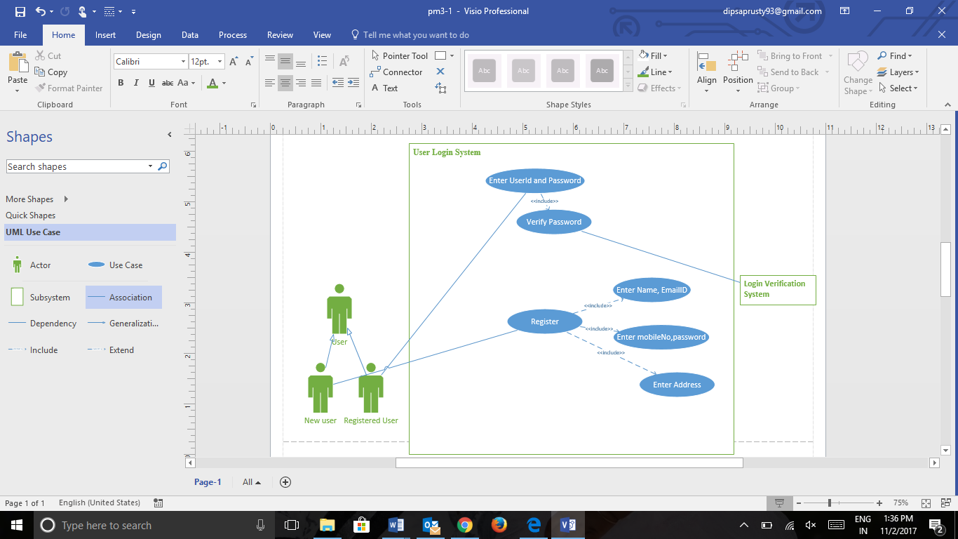
Use case diagram for User Login System

Slide 6
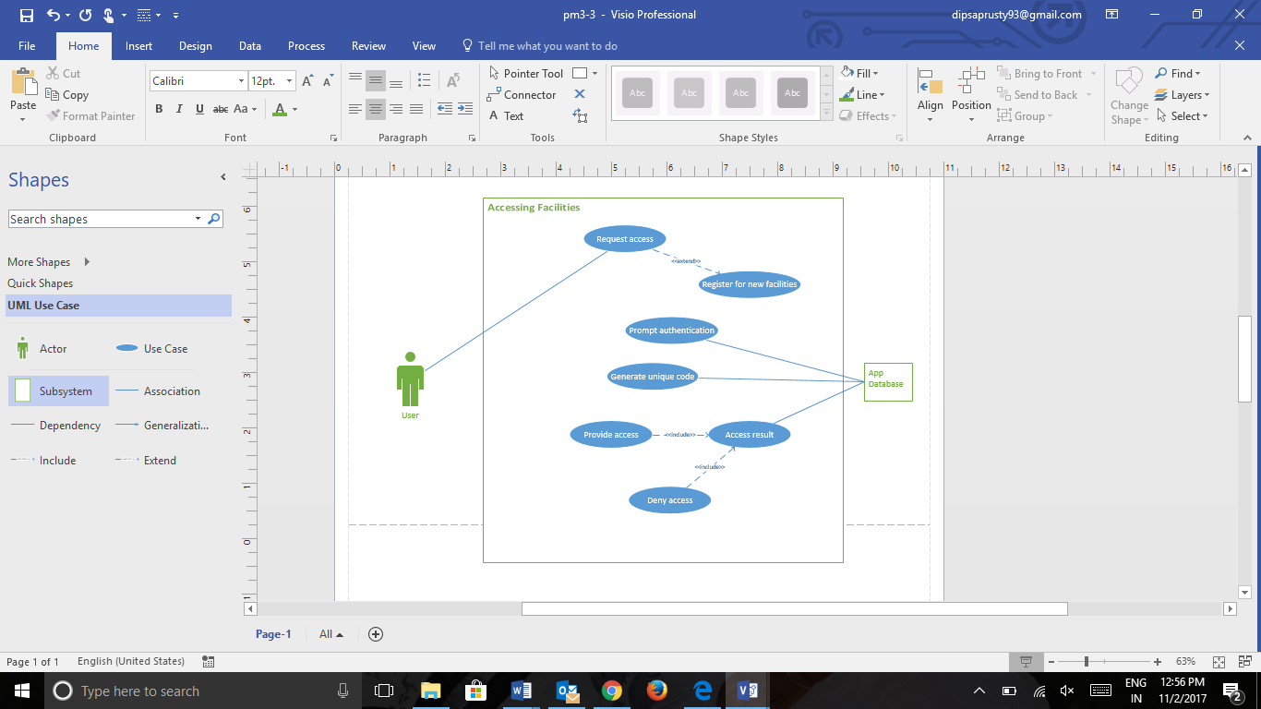
Use case diagram for accessing facilities

Slide 7
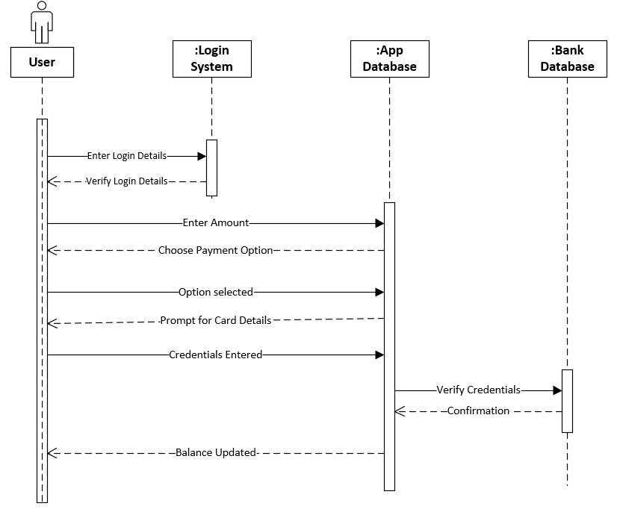
Sequence diagram for adding balance to CometApp

Slide 8
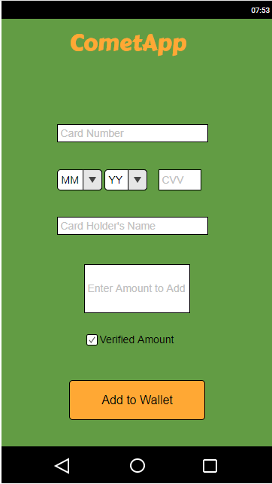
User Interface for adding balance to CometApp

Slide 9
CONTROLS
Login Verification:
The Login verification method is an entry control and will help to detect fraudulent/malicious activity.
Only a registered user who has a valid comet card can login through the system. This control method will carry out checks for user ID and password. After 3 unsuccessful attempts to login, the system will prompt to reset the password for the account for security purpose.

Slide 10
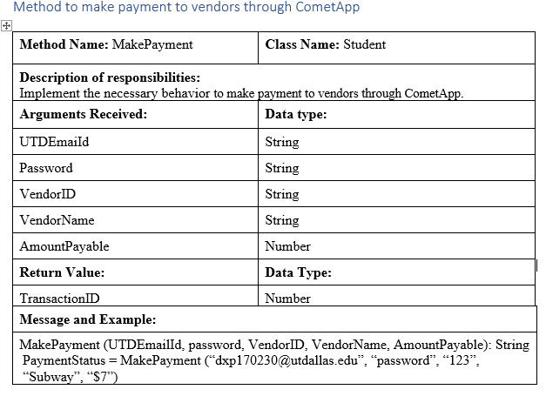
Software Design

Slide 11
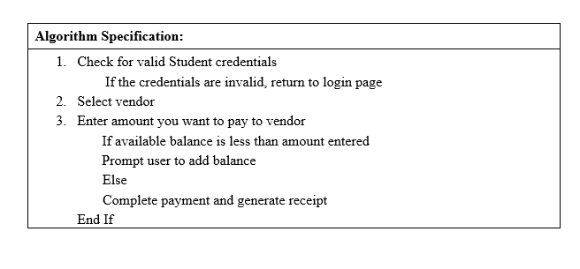
Software Design(Contd..)

Slide 12
TEST CASE TO VERIFY STUDENT LOGIN
Purpose:
To verify the login credentials of a student and make sure that he/she can login.
Prerequisite:
The student should have already finished registration with the Comet App.
Test Data:
UTDEmailID = [Valid UTDEmailID, Invalid UTDEmailID, Empty]
Password = [Valid Password, Invalid Password, Empty]

Slide 13
TEST CASE TO VERIFY STUDENT LOGIN
Procedure:
Steps | Expected result
Click on the Login link. | Student will be redirected to the Login Page.
Enter the Login ID ie. UTDEmailID and the Password. | Student should be able to enter the required details.
Click on the Login button. | Student should be able to login if the credentials are valid. If the login credentials are invalid, throw Login status as Failed.

Slide 14
Lessons Learnt
Depending on the priorities of the available resources, selection of the project and determining the importance of the project.
The work breakdown structure gave details about the tasks to be performed at various phases of project and time management.
The designing of different models and its importance was analyzed.
Coordination between the team members for successful accomplishment of project.
User Interface was designed in the perspective of the user for efficient usage.
Significance of security for the application and enforcing data encryption for the security of students

Slide 15

Thank you

